Slide 1

P peline
The Data
Review of CAP and Regression
© Jennifer Mankoff
The Data Pipeline; HCII; Spring 2014

Slide 2
Goals for today
Quiz 8 answers
Quiz 9
Byte 5 Results
Final Project Discussion
Review last Tuesday
CAP
Logistic Regression

Slide 3
Maximum Accuracy of >68%
Tweaked features
Removed ‘Sex’
Removed unknown ages
Tweaked algorithm
Chose entropy over Gini for split choice

Slide 4
Other tweaks
Playing around with decision tree depth No one did this systematically….

Slide 5
Other tweaks
Playing around with decision tree depth
Imputing or removing missing values Not clear how effective this was
Side note: No one did t-test between before and after recognizers!

Slide 6
Other tweaks
Playing around with decision tree depth
Imputing or removing missing values
Reducing the number of categories within individual features 63->66%
This was a potentially big gain. Too few of you tried it! The person who did try it started lower than everyone else (not sure why)

Slide 7
Other tweaks
Playing around with decision tree depth
Imputing or removing missing values
Reducing the number of categories within individual features 63->66%
Reducing total number of features
Any thoughts on why this was not effective?
When is many features a problem?
When is overfitting a problem?

Slide 8
Other tweaks
Playing around with decision tree depth
Imputing or removing missing values
Reducing the number of categories within individual features 63->66%
Reducing total number of features
Trying different classifiers may work but you should study them first and not a focus of the class

Slide 9
Mistakes & Other thoughts
Adding anything with ‘Outcome’ in the title
Why is SpayNeuter so prominent?
Outcome options might need tweaking (is other mostly similar to ‘fail’? Is it big enough to keep?)

Slide 10
Office hours for byte 6
Tuesday: 12-1pm
Thursday 10:30-11am

Slide 11
Goals for today
Quiz 8 answers
Quiz 9
Byte 5 Results
Final Project Discussion
Revisit:
CAP
Logistic Regression

Slide 12
CAP Theorem
Cannot maximize Consistency, Availability and Partition Tolerance (in the event of a partial failure).
Every data storage solution makes tradeoffs

Slide 13
CAP Theorem
Cannot maximize Consistency,
all nodes see the same data at the same time

Slide 14
CAP Theorem
Cannot maximize Consistency, Availability
every request receives a response about whether it was successful or failed

Slide 15
CAP Theorem
Cannot maximize Consistency, Availability and Partition Tolerance
system continues to operate despite arbitrary message loss or failure of part of the system
relates to latency or e.g. mobile devices partly connected
Suggests a scope for C&A

Slide 16
CAP Theorem
Cannot maximize Consistency, Availability and Partition Tolerance (in the event of a partial failure).
Specific to distribute systems
“The modern CAP goal should be to maximize combinations of consistency and availability that make sense for the specific application”
http://www.infoq.com/articles/cap-twelve-years-later-how-the-rules-have-changed
Notes:
The easiest way to understand CAP is to think of two nodes on opposite sides of a partition. Allowing at least one node to update state will cause the nodes to become inconsistent, thus forfeiting C. Likewise, if the choice is to preserve consistency, one side of the partition must act as if it is unavailable, thus forfeiting A. Only when nodes communicate is it possible to preserve both consistency and availability, thereby forfeiting P. Usually we assume P and then have to choose between C and A

Slide 17
CAP Theorem
Don’t be overly simplistic
CAP are continuous, not binary
CAP can be re balanced at each decision
Partitions are rare -> mostly CA are both ok
Notes:
Although both terms are more mnemonic than precise, the BASE acronym (being second) is a bit more awkward: Basically Available, Soft state, Eventually consistent. Soft state and eventual consistency are techniques that work well in the presence of partitions and thus promote availability.
The relationship between CAP and ACID is more complex and often misunderstood, in part because the C and A in ACID represent different concepts than the same letters in CAP and in part because choosing availability affects only some of the ACID guarantees. The four ACID properties are:
Atomicity (A). All systems benefit from atomic operations. When the focus is availability, both sides of a partition should still use atomic operations. Moreover, higher-level atomic operations (the kind that ACID implies) actually simplify recovery.
Consistency (C). In ACID, the C means that a transaction pre-serves all the database rules, such as unique keys. In contrast, the C in CAP refers only to single]copy consistency, a strict subset of ACID consistency. ACID consistency also cannot be maintained across partitions.partition recovery will need to restore ACID consistency. More generally, maintaining invariants during partitions might be impossible, thus the need for careful thought about which operations to disallow and how to restore invariants during recovery.
Isolation (I). Isolation is at the core of the CAP theorem: if the system requires ACID isolation, it can operate on at most one side during a partition. Serializability requires communication in general and thus fails across partitions. Weaker definitions of correctness are viable across partitions via compensation during partition recovery.
Durability (D). As with atomicity, there is no reason to forfeit durability, although the developer might choose to avoid needing it via soft state (in the style of BASE) due to its expense. A subtle point is that, during partition recovery, it is possible to reverse durable operations that unknowingly violated an invariant during the operation. However, at the time of recovery, given a durable history from both sides, such operations can be detected and corrected. In general, running ACID transactions on each side of a partition makes recovery easier and enables a framework for compensating transactions that can be used for recovery from a partition.

Slide 18
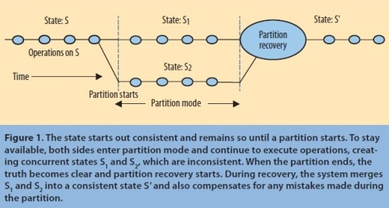
CAP Theorem
Don’t be overly simplistic
CAP are continuous, not binary
CAP can be re balanced at each decision
Partitions are rare -> mostly CA are both ok
Figure from: http://www.infoq.com/articles/cap-twelve-years-later-how-the-rules-have-changed
Notes:
Although both terms are more mnemonic than precise, the BASE acronym (being second) is a bit more awkward: Basically Available, Soft state, Eventually consistent. Soft state and eventual consistency are techniques that work well in the presence of partitions and thus promote availability.
The relationship between CAP and ACID is more complex and often misunderstood, in part because the C and A in ACID represent different concepts than the same letters in CAP and in part because choosing availability affects only some of the ACID guarantees. The four ACID properties are:
Atomicity (A). All systems benefit from atomic operations. When the focus is availability, both sides of a partition should still use atomic operations. Moreover, higher-level atomic operations (the kind that ACID implies) actually simplify recovery.
Consistency (C). In ACID, the C means that a transaction pre-serves all the database rules, such as unique keys. In contrast, the C in CAP refers only to single]copy consistency, a strict subset of ACID consistency. ACID consistency also cannot be maintained across partitions.partition recovery will need to restore ACID consistency. More generally, maintaining invariants during partitions might be impossible, thus the need for careful thought about which operations to disallow and how to restore invariants during recovery.
Isolation (I). Isolation is at the core of the CAP theorem: if the system requires ACID isolation, it can operate on at most one side during a partition. Serializability requires communication in general and thus fails across partitions. Weaker definitions of correctness are viable across partitions via compensation during partition recovery.
Durability (D). As with atomicity, there is no reason to forfeit durability, although the developer might choose to avoid needing it via soft state (in the style of BASE) due to its expense. A subtle point is that, during partition recovery, it is possible to reverse durable operations that unknowingly violated an invariant during the operation. However, at the time of recovery, given a durable history from both sides, such operations can be detected and corrected. In general, running ACID transactions on each side of a partition makes recovery easier and enables a framework for compensating transactions that can be used for recovery from a partition.

Slide 19
Contrast: Typical Relational Database
Atomicity: Good for CAP too.
When the focus is availability, both sides of a partition should still use atomic operations.
Also simplify recovery.
Notes:
The relationship between CAP and ACID is more complex and often misunderstood, in part because the C and A in ACID represent different concepts than the same letters in CAP and in part because choosing availability affects only some of the ACID guarantees. The four ACID properties are:
Atomicity (A). All systems benefit from atomic operations. When the focus is availability, both sides of a partition should still use atomic operations. Moreover, higher-level atomic operations (the kind that ACID implies) actually simplify recovery.

Slide 20
Contrast: Typical Relational Database
Atomicity: Good for CAP too.
Consistency: Different in CAP
Relational: a transaction pre-serves all the database rules, such as unique keys.
CAP: single copy consistency, a strict subset of ACID consistency (otherwise cannot be maintained across partitions)
Partition recovery restores ACID consistency
Notes:
Consistency (C). In ACID, the C means that a transaction pre-serves all the database rules, such as unique keys. In contrast, the C in CAP refers only to single copy consistency, a strict subset of ACID consistency. ACID consistency also cannot be maintained across partitions.partition recovery will need to restore ACID consistency. More generally, maintaining invariants during partitions might be impossible, thus the need for careful thought about which operations to disallow and how to restore invariants during recovery.

Slide 21
Contrast: Typical Relational Database
Atomicity: Good for CAP too.
Consistency: Different in CAP
Isolation: core of CAP theorem
Reduces functionality during a partition because serializability requires communication.
instead CAP can weaken correctness and compensate during recovery
Notes:
Isolation (I). Isolation is at the core of the CAP theorem: if the system requires ACID isolation, it can operate on at most one side during a partition. Serializability requires communication in general and thus fails across partitions. Weaker definitions of correctness are viable across partitions via compensation during partition recovery.

Slide 22
Contrast: Typical Relational Database
Atomicity: Good for CAP too.
Consistency: Different in CAP
Isolation: core of CAP theorem
Durability: Good for CAP too (but can be expensive)
Notes:
Durability (D). As with atomicity, there is no reason to forfeit durability, although the developer might choose to avoid needing it via soft state (in the style of BASE) due to its expense. A subtle point is that, during partition recovery, it is possible to reverse durable operations that unknowingly violated an invariant during the operation. However, at the time of recovery, given a durable history from both sides, such operations can be detected and corrected

Slide 23
Real Implications of CAP
Always support Partition Tolerance (but know they are rare)
Run ACID transactions on each side of a partition
makes recovery easier
enables a framework for compensating transactions that can be used for recovery from a partition.
Support BASE (Basically Available, Soft state, Eventually consistent) during partitions

Slide 24
Goals for today
Quiz 8 answers
Quiz 9
Byte 5 Results
Final Project Discussion
Review last Tuesday
CAP
Logistic Regression

Slide 25
Estimated Regression Model
y
Observed y for x_{i}
Random Error for x_{i}
e_{i}
b₁
Predicted for x_{i}
b₀
x
x_{i}
x
The individual random error terms e_{i} have a mean of zero
Notes:
This works in two dimensions

Slide 26
An Example: Animal Outcomes
Result is no longer continuous:
Will an animal be successfully placed (or euthanized?)
1 Placed
2 Euthanized

Slide 27
Goal of Logistic Regression
Key idea: instead of predicting a number in R, predict the probability p of a class label given a set of features X
p+ = P(class is positive | X) p- = P(class is negative | X)

Slide 28
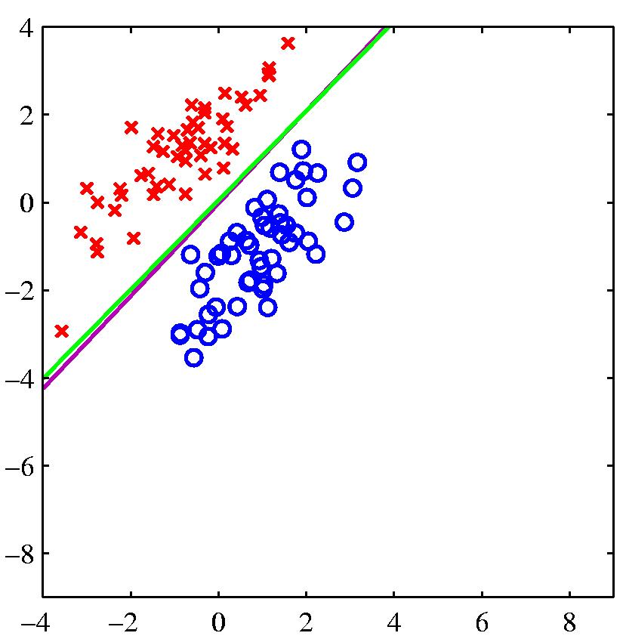
Estimated Logistic Regression Model
Given training examples:
x_{1..i} in R^{n} [our feature vectors]
And labels
y_{1..i} in R
we want to learn w^{T}x + b + e
(that’s just matrix speak for α + βX + e
Notes:
This works in two dimensions

Slide 29
Modeling Logistic Regression
We want to decide a class
The "logit" model solves these problems: ln[p/(1-p)] = α + βX + e
p is the probability that the event Y occurs, p(Y=1)
p/(1-p) is the "odds ratio"
ln[p/(1-p)] is the log odds ratio, or "logit"
WhitHead: www.appstate.edu/~whiteheadjc/service/logit/logit.ppt

Slide 30
More:
The logistic distribution constrains the estimated probabilities to lie between 0 and 1.
The estimated probability is: Since ln[p/(1-p)] = α + βX + e p = 1/[1 + exp(-α - β X +e)]
Called
if you let α + β X =0, then p = .50
as α + β X gets really big, p approaches 1
as α + β X gets really small, p approaches 0
WhitHead: www.appstate.edu/~whiteheadjc/service/logit/logit.ppt

Slide 31
Squeezes the real line into [0,1]
Differentiable: (nice exercise)

Slide 32
Logistic regression
we want to minimize an error term based on w
When E(w) is minimized we have our best fit
Notes:
P(1+exp(-y)) = 1
P + pexp(-y) = 1
Pexp(-y) = 1-p
p(e^-y)(e^y) = 1-p (e^y)
p/(1-p) = e^y

Slide 33
Logistic regression
we want to minimize an error term based on w
When E(w) is minimized we have our best fit
a ‘loss’ function whose definition can vary (affects the details of what we learn)
Notes:
an upper bound on mis-classification error

Slide 34
Logistic regression
The actual correct class (the label, based on our training data)
we want to minimize an error term based on w
When E(w) is minimized we have our best fit

Slide 35
Logistic regression
we want to minimize an error term based on w
When E(w) is minimized we have our best fit
The predicted class (x.w)

Slide 36
Logistic regression
we want to minimize an error term based on w
When E(w) is minimized we have our best fit
a ‘regularization term’ which penalizes model complexity

Slide 37
Logistic regression
we want to minimize an error term based on w
When E(w) is minimized we have our best fit
A parameter which affects R’s impact on the search

Slide 38
Gradient Descent
Loops over the entire data set S
At each step change w based on the error and the step size η
w_{j} = w_{i} - η Δ(w)

Slide 39
Questions about HW 6?

